Slide 1
Project: Toy store data analysis

Slide 2
SQl case StudY
We have access to data of Toy store chain with multiple locations in Barcelona, Spain containing transactional records from January 2022 till Sept 2023, along with the information about products and store locations.
Using SQL we need to analyse product performance, store performance ,monthly sales , profit margin etc.

Slide 3
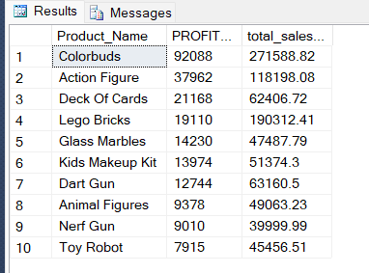
1) Identify top-performing products based on total sales and profit.
SELECT
TOP (10) P.Product_Name, sum([PRODUCT_PRICE in dollar]-[Product Cost in dollar]) AS PROFIT_$,
round(sum(s.units *p.[product_price in dollar]),2) as total_sales_$
FROM
PRODUCTS p
JOIN sales S
ON p.Product_ID=S.product_id
group by p.Product_Name
ORDER BY PROFIT_$ desc,total_sales_$ desc;
Output

Slide 4
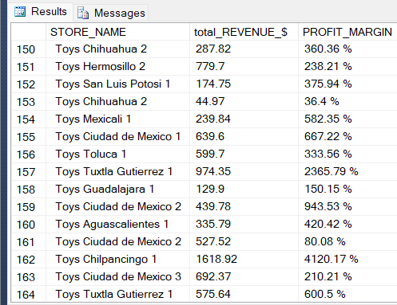
2) Analyse sales performance for each store, including total revenue and profit margin.
SELECT
ST.STORE_NAME,round(SUM(S.UNITS *P.[PRODUCT_PRICE in dollar]),2) as total_REVENUE_$,
CONCAT(ROUND(SUM(
(P.[PRODUCT_PRICE in dollar]-P.[Product Cost in dollar])/
(p.[Product Cost in Dollar]))*100,2),' ','%')
AS PROFIT_MARGIN
FROM
sales S
JOIN stores ST
ON S.Store_ID=ST.Store_ID
JOIN products P
ON S.Product_ID= P.Product_ID
group by store_name,(P.[PRODUCT_PRICE in dollar]-P.[Product Cost in dollar])/
(p.[product_price in dollar]),
S.units *p.[product_price in dollar];
Output

Slide 5
3) Examine monthly sales trends, considering the rolling 3-month average and identifying months with significant growth or decline.
WITH MonthlySales AS (
SELECT
YEAR(c.date) AS year,MONTH(c.date) AS month,
AVG(s.units *p.[product_price in dollar]) AS monthly_average
FROM sales s
join Calender c
on s.Date=c.Date
join products p
on s.Product_ID=p.Product_ID
GROUP BY
YEAR(c.Date),
MONTH(c.date)
),
RollingAverage AS (
SELECT
year,
month,
monthly_average,
AVG(monthly_average) OVER (ORDER BY year, month ROWS BETWEEN 2 PRECEDING AND CURRENT ROW) AS rolling_average
FROM
MonthlySales
)
………….

Slide 6
SELECT
CONCAT(year, '-', RIGHT('0' + CAST(month AS VARCHAR(2)), 2), '-01') AS month_start,
round( monthly_average,2) as monthly_Average,
round(rolling_average,2) as rolling_Average,
CASE
WHEN rolling_average > LAG(rolling_average) OVER (ORDER BY year, month) THEN 'Growth'
WHEN rolling_average < LAG(rolling_average) OVER (ORDER BY year, month) THEN 'Decline'
ELSE 'No Change'
END AS trend
FROM
RollingAverage
ORDER BY
year, month;
Output

Slide 7
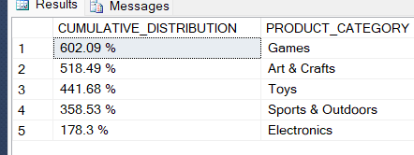
4) Calculate the cumulative distribution of profit margin for each product category, consider where products are having profit.
WITH ProfitMargin as(
select
Product_Category,
ROUND((
([PRODUCT_PRICE in dollar]-[Product Cost in dollar])/[Product Cost in Dollar])*100,2)
AS PROFIT_MARGIN
from
PRODUCTS
)
SELECT
CONCAT(SUM(PROFIT_MARGIN),' ','%') as CUMULATIVE_DISTRIBUTION,PRODUCT_CATEGORY
FROM
ProfitMargin
group by PRODUCT_CATEGORY
HAVING SUM(PROFIT_MARGIN)>0
ORDER BY SUM(PROFIT_MARGIN) DESC;
Output

Slide 8
5) Analyze the efficiency of inventory turnover for each store by calculating the Inventory Turnover Ratio.
WITH StoreInventory AS (
SELECT
stores.store_id,stores.store_name,
DATEADD(MONTH, DATEDIFF(MONTH, 0, c.date), 0) AS month_start,
EOMONTH(c.date) AS month_end,
SUM(i.stock_on_hand) AS total_inventory
FROM
sales s
join Calender c
on s.Date=c.Date
join inventory i
on s.Product_ID=i.Product_ID
join stores
on s.Store_ID=stores.store_id
GROUP BY
stores.store_id,stores.store_name,
DATEADD(MONTH, DATEDIFF(MONTH, 0, c.date), 0),
EOMONTH(c.date)
)
………….

Slide 9
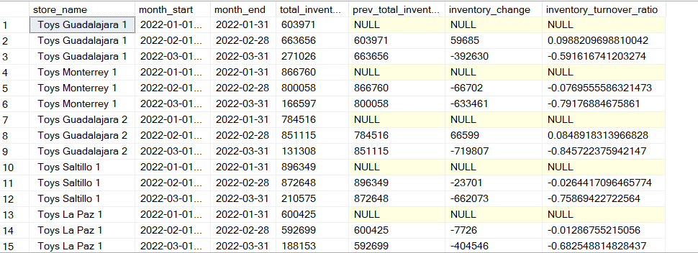
SELECT
store_id,store_name, month_start, month_end,total_inventory,
LAG(total_inventory) OVER (PARTITION BY store_id ORDER BY month_start) AS prev_total_inventory,
total_inventory - LAG(total_inventory) OVER (PARTITION BY store_id ORDER BY month_start) AS inventory_change,
CASE
WHEN LAG(total_inventory) OVER (PARTITION BY store_id ORDER BY month_start) IS NOT NULL AND
LAG(total_inventory) OVER (PARTITION BY store_id ORDER BY month_start) <> 0
THEN
(total_inventory - LAG(total_inventory) OVER (PARTITION BY store_id ORDER BY month_start)) /
LAG(total_inventory) OVER (PARTITION BY store_id ORDER BY month_start)
ELSE
NULL
END AS inventory_turnover_ratio
FROM
StoreInventory;
Output

Slide 10
Findings
The highest selling as well as highest profit generating product across different toy stores is colorbuds followed by Action Figure and Deck of cards. So we should concentrate more on availability and timely restocking of these products.
Based on the store wise performance, the store named Toy Mexicali 1 is having highest profit margin of 51.87% followed by Toys Campeche 1 (51.75%).
Sports and outdoors have generated maximum profit followed by Games. Toys are the lowest profit generating product. We need to identify whether designs, packaging , price et5c parameters of Toys are market competitive or not.

Slide 11
Findings
Inventory Turnover Ratio (the ratio indicates how well a company is managing it’s inventory)
of most of the toy stores has drastically increased over the months which is favorable to the
business. It suggests Company is selling and restocking its inventory more frequently.

Slide 12
Thanks!
Do you have any questions?
Doyel.maiti13@gmail.com
https://www.linkedin.com/in/doyel-maiti-0120b2255/

